Slide 1


Amazon Sales Analysis
Using Sql

Slide 2

Objective
We are analyzing Amazon sales data to identify high-performing branches and products, analyze the sales patterns of various products, and understand customer behavior.
The primary objective is to enhance and optimize sales strategies.
Agenda
The main goal of this project is to gain understanding from amazon sales data, exploring the various factors that influence sales across different branches.

Slide 3
Data Exploration
Data Collection and Understanding
Exploring the shape ,structure of the data , Feature and relationship within it
Data Preprocessing
1.Data Cleaning
Removing duplicates ,checking for missing values or any incomplete data
2. Feature Engineering
Analysis the Data columns and generate new columns out of existing one

Slide 4
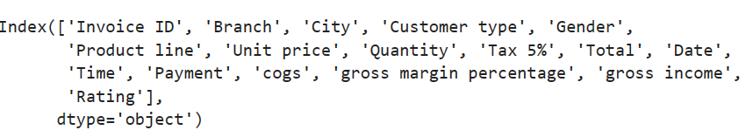
About Data
Data contains about transaction of amazon customer with three branches among cities like Mandalay, Yangon, and Naypyitaw, respectively
Data consists of 1000 rows and 17 columns

Slide 5
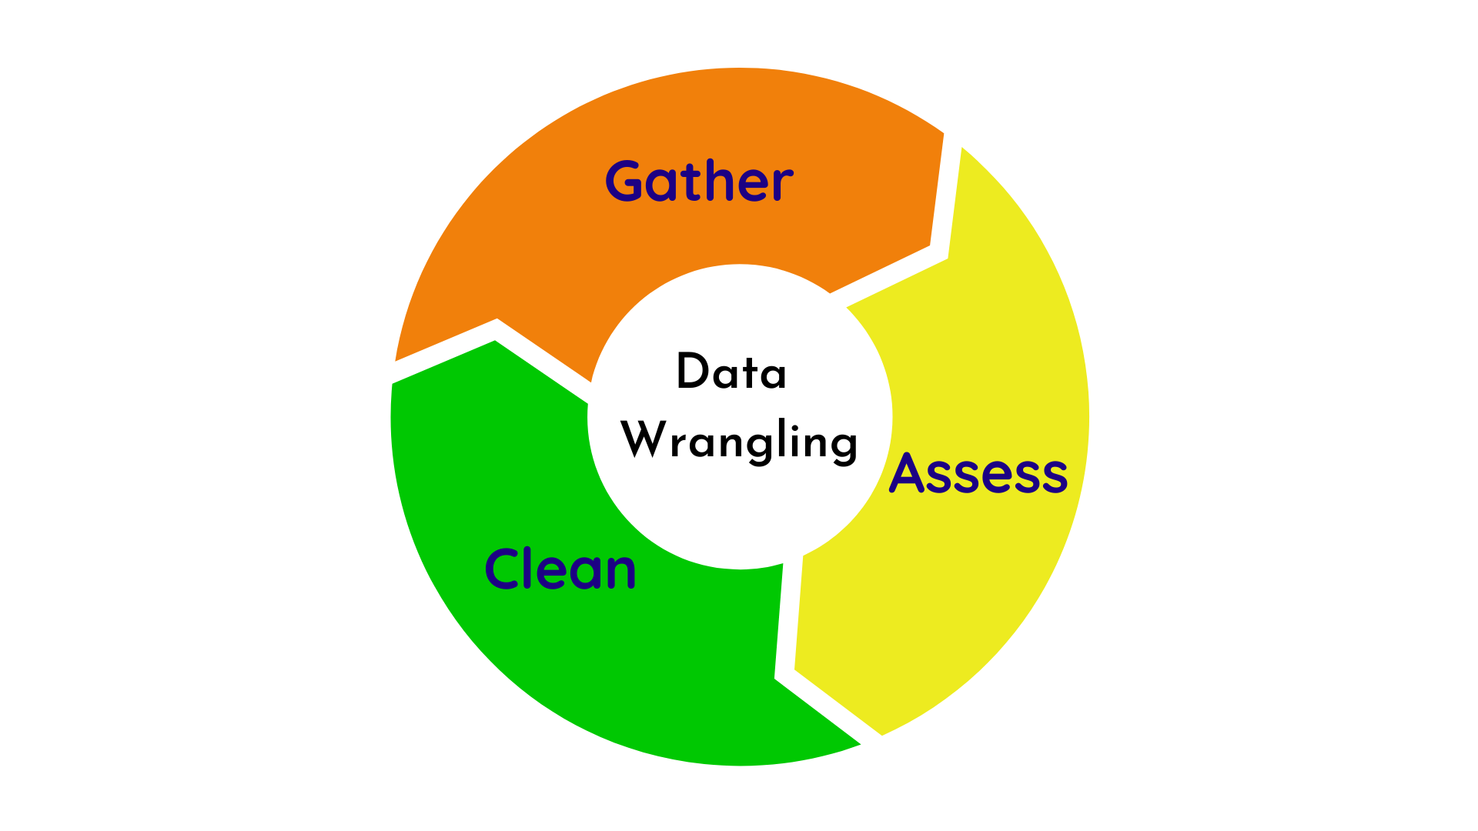
Insights from Data Exploration
1
Null values are not found in the given data.
2
Renaming column Names
3
Adding more 3 columns
Monthname
DayName
timeofday

Slide 6
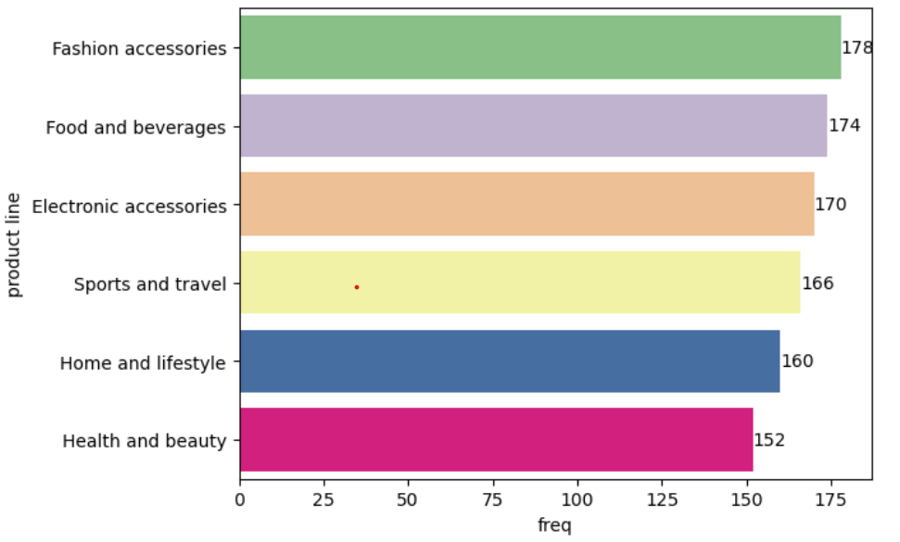
Branches with corresponding cities and Product lines
A | Yangon
B | Mandalay
C | Naypyitaw
6 Distinct Product Lines

Slide 7
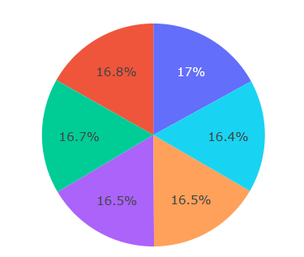
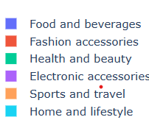
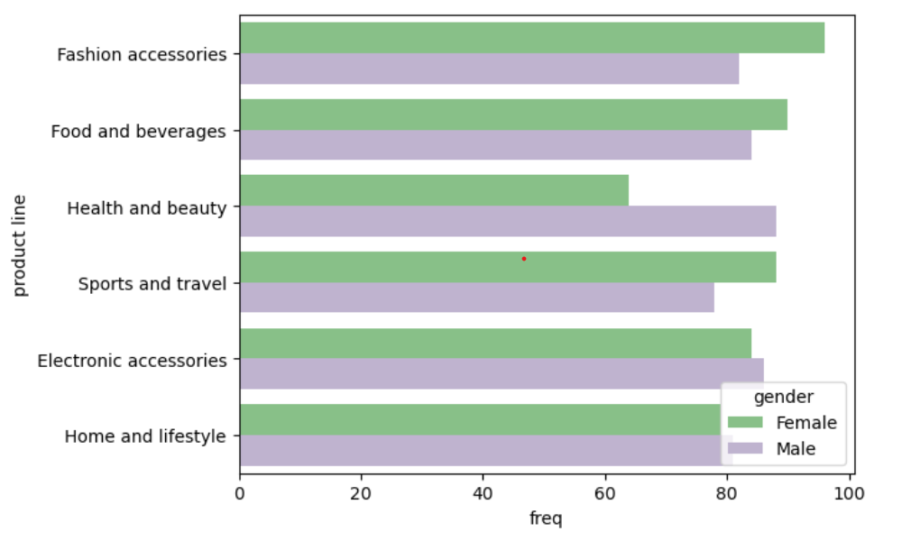
Product Analysis
Most selling product line is ‘Fashion Accessories’, ’Foods and Beverages’ and ’Electronic Accessories’.
Least Selling Product line is ‘Health and Beauty’, ’Home and Lifestyle’ and ‘Sports and travel’
Average rating of each product line Based on Gender , Frequently sold Product Lines

Slide 8
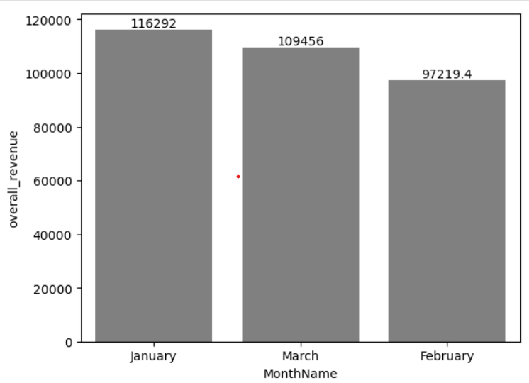
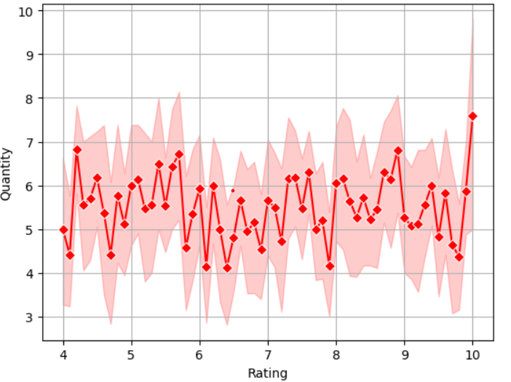
Product Revenue
Month Wise analysis on Revenue Impact of Quantity based on Rating

Slide 9
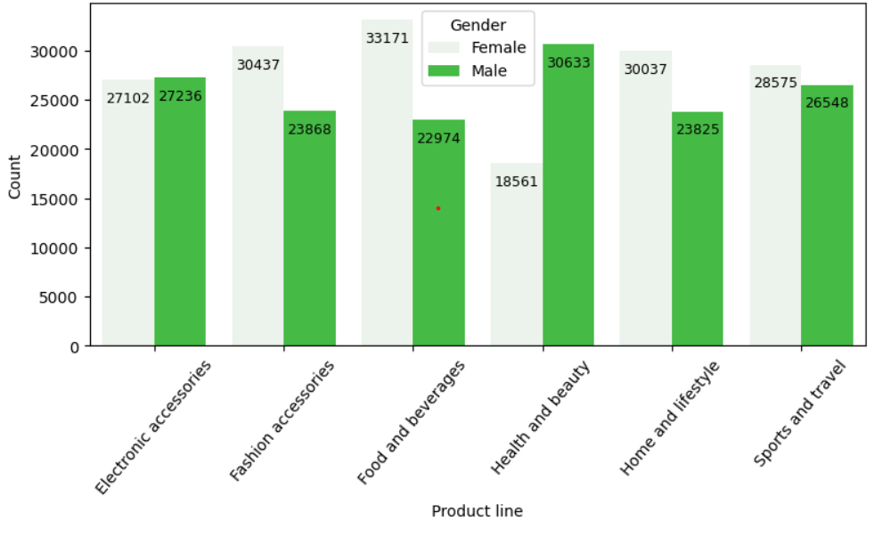
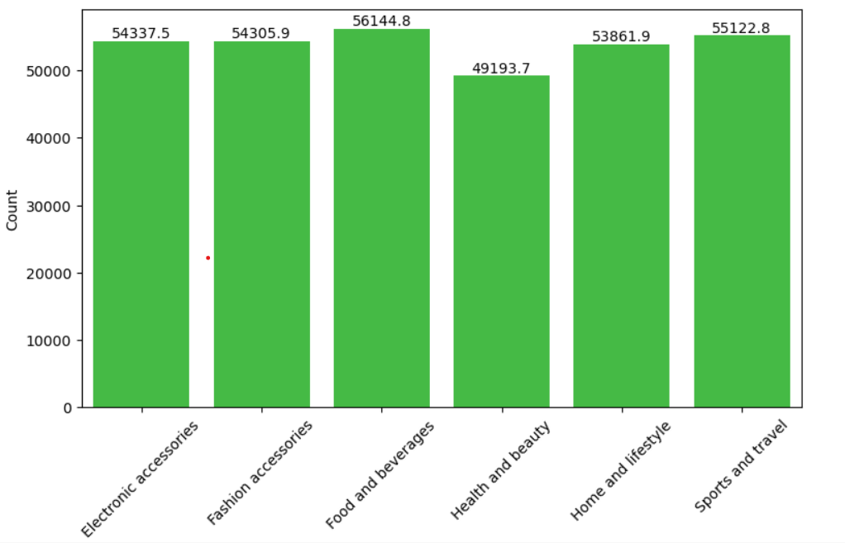
Sales Analysis

Slide 10
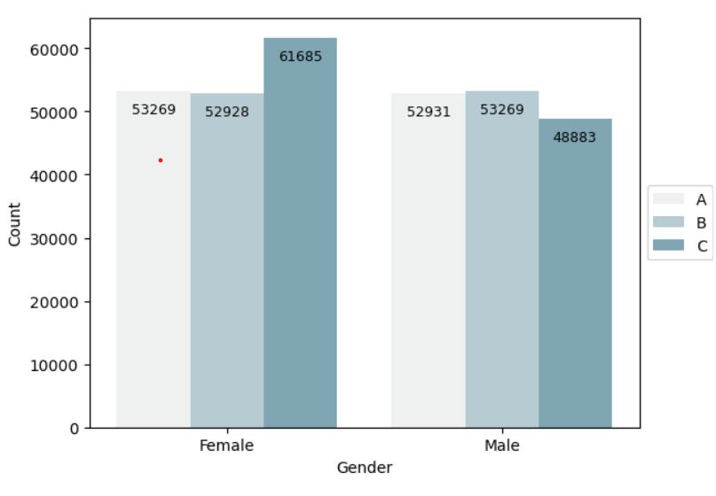
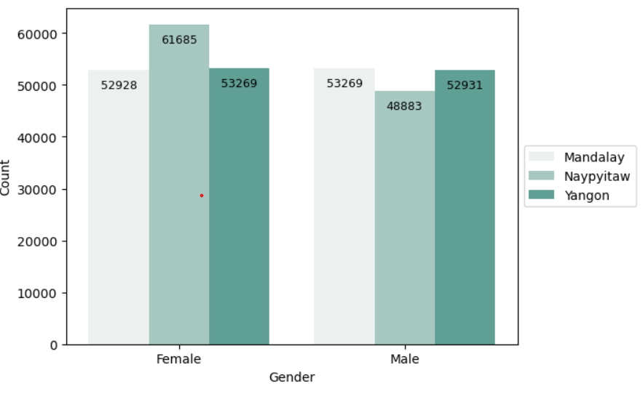
Sales based on Branch and Cities

Slide 11
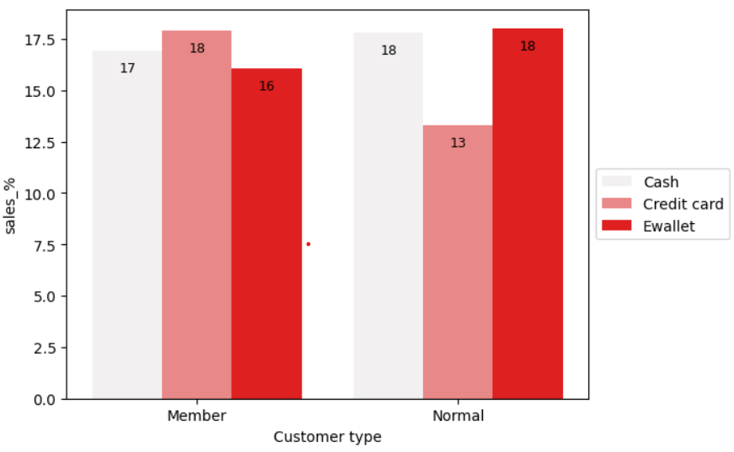
Customer Analysis
Customer type along payment method are playing curial role on Sales
Member customer type are buying most frequently
Member Use credit card for payment than ewallet
Ewallet-payment type is mostly used by Normal Customer
Member ---1,64,223.44
Normal ---1,58,743.30

Slide 12
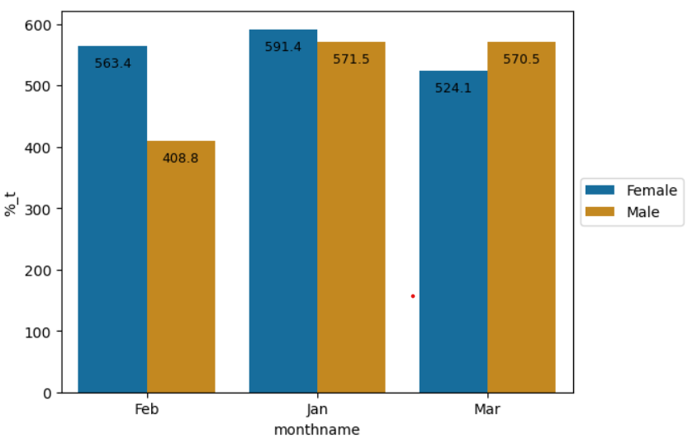
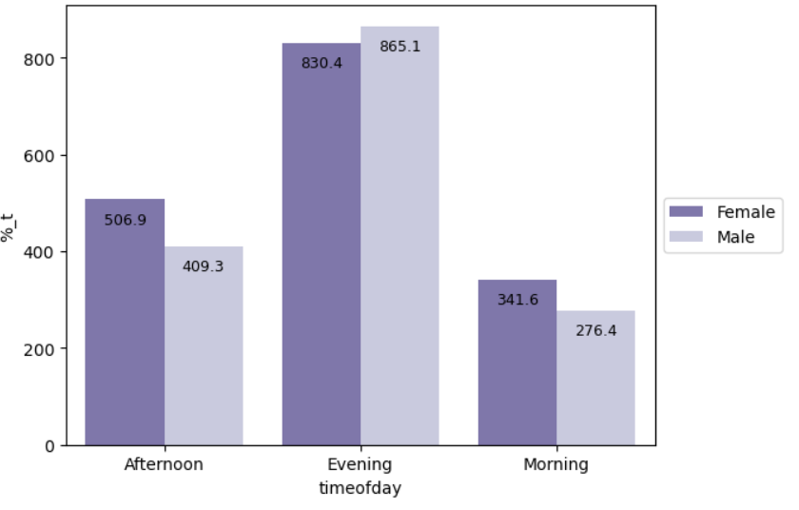
Customer Analysis
Afternoon | 275
Morning | 191
Evening | 534
Sales are made in the evening than Morning

Slide 13
Insights
In Month Analysis , Jan and March have increased in sales , as its an festival season.
Quantity is been raising based on the rating provide for the individual product
Sports and travel , Home and lifestyle rating are less , so we can sales rate trending low
Based on Gender analysis , Female purchase rate is high on Product lines and Branch C has performed well , so need to focus on A and B branch to increase sales . Male purchase on Health and Beauty product where female sales are less.
Majority of the customer pay through E Wallet and mostly commonly used by normal customer type.
Naypyitaw is the city with most female customers than yangon with male customers
With time of day Analysis, sales are increased in Evening than morning irrespective of the gender

